Slide 1
JavaFX Basics
Part 3

Slide 2
Objectives
To create user interfaces using shapes (§14.4).
To use binding properties to synchronize property values (§14.5).
To use the common properties style and rotate for nodes (§14.6).
To create colors using the Color class (§14.7).
To create fonts using the Font class (§14.8).
To create images using the Image class and to create image views using the ImageView class (§14.9).
To display text using the Text class and create shapes using Line, Circle, Rectangle, Ellipse, Arc, Polygon, and Polyline (§14.11).
To develop the reusable GUI components ClockPane for displaying an analog clock (§14.12).

Slide 3
Display a Shape
This example displays a circle in the center of the pane.
ShowCircle
Run

Slide 4
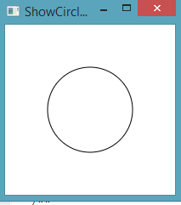
Binding Properties
import javafx.application.Application; import javafx.scene.Scene; import javafx.scene.layout.Pane; import javafx.scene.paint.Color; import javafx.scene.shape.Circle; import javafx.stage.Stage; public class ShowCircleCentered extends Application { public void start(Stage primaryStage) { // Create a pane to hold the circle Pane pane = new Pane(); // Create a circle and set its properties Circle circle = new Circle(); circle.centerXProperty().bind(pane.widthProperty().divide(2)); circle.centerYProperty().bind(pane.heightProperty().divide(2)); circle.setRadius(50); circle.setStroke(Color.BLACK); circle.setFill(Color.WHITE); pane.getChildren().add(circle); // Add circle to the pane // Create a scene and place it in the stage Scene scene = new Scene(pane, 200, 200); primaryStage.setTitle("ShowCircleCentered"); // Set the stage title primaryStage.setScene(scene); // Place the scene in the stage primaryStage.show(); // Display the stage } /** * The main method is only needed for the IDE with limited * JavaFX support. Not needed for running from the command line. */ public static void main(String[] args) { launch(args); } }
ShowCircleCentered
JavaFX introduces a new concept called binding property that enables a target object to be bound to a source object. If the value in the source object changes, the target property is also changed automatically. The target object is simply called a binding object or a binding property.

Slide 5
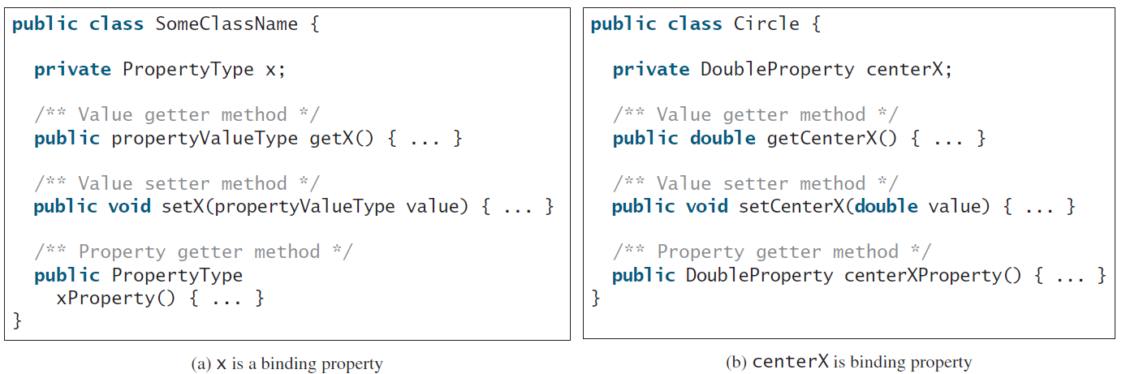
Binding Property: getter, setter, and property getter

Slide 6
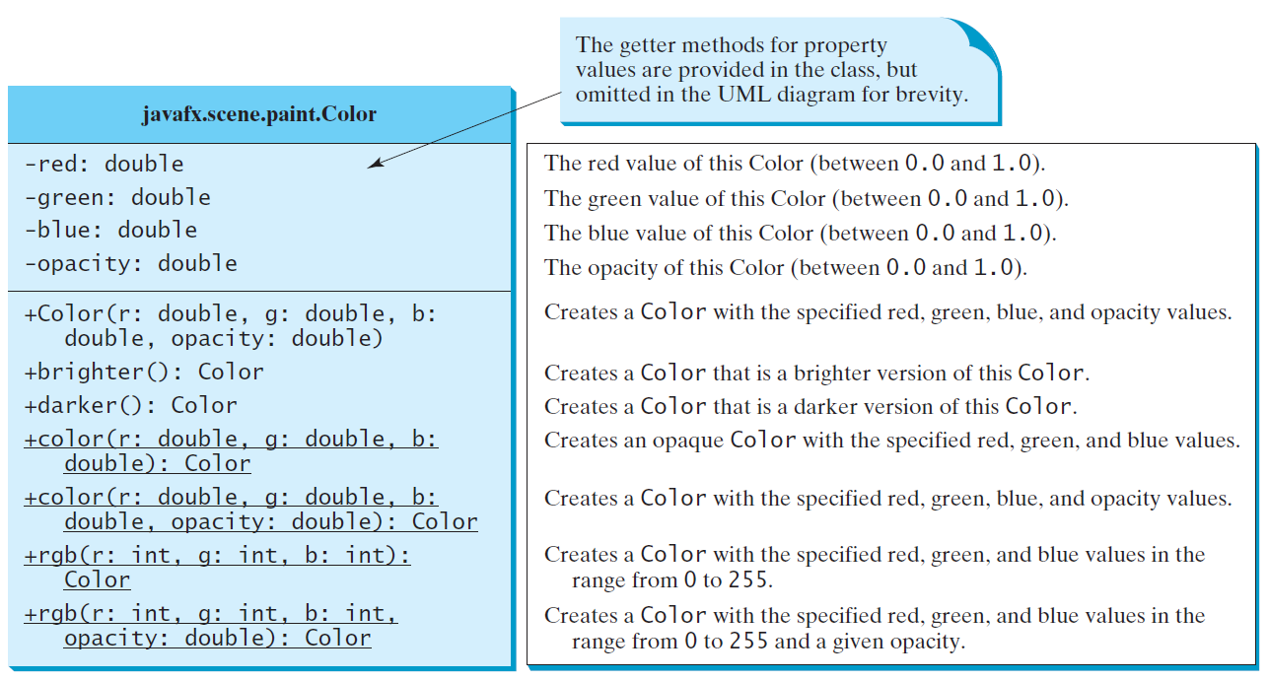
The Color Class

Slide 7
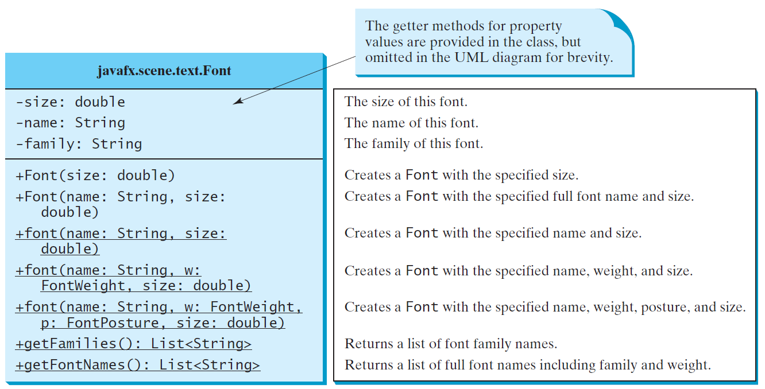
The Font Class
FontDemo
Run

Slide 8
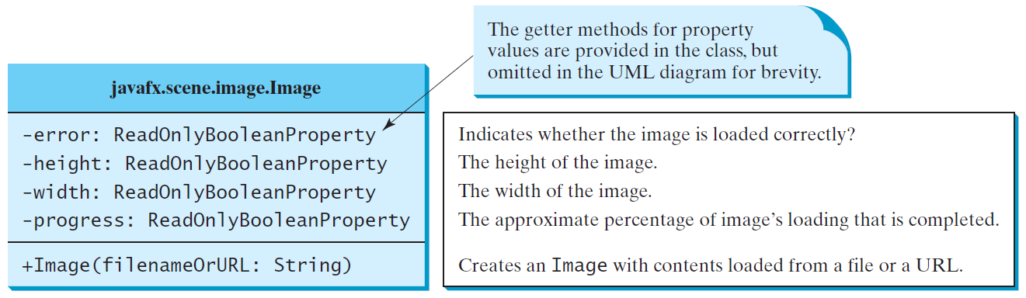
The Image Class

Slide 9
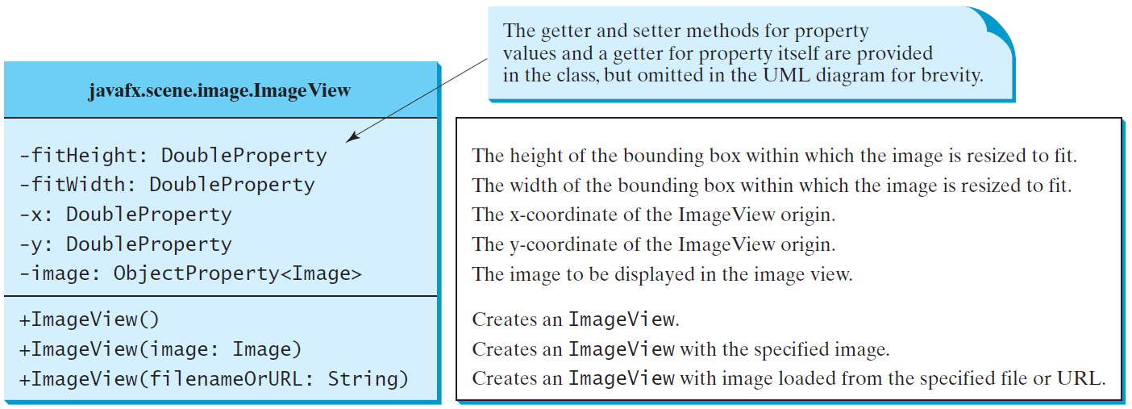
The ImageView Class
ShowImage
Run

Slide 10
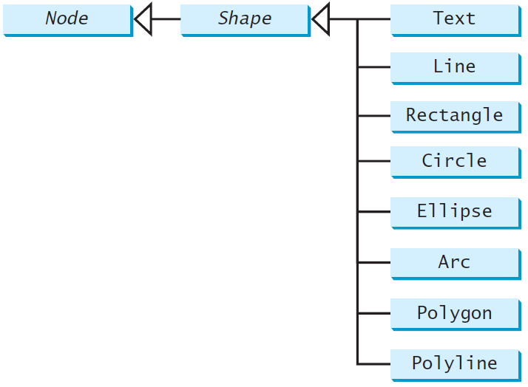
Shapes
JavaFX provides many shape classes for drawing texts, lines, circles, rectangles, ellipses, arcs, polygons, and polylines.

Slide 11
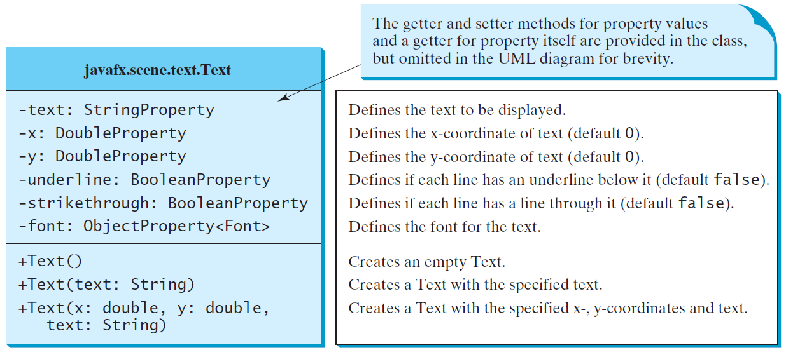
Text

Slide 12
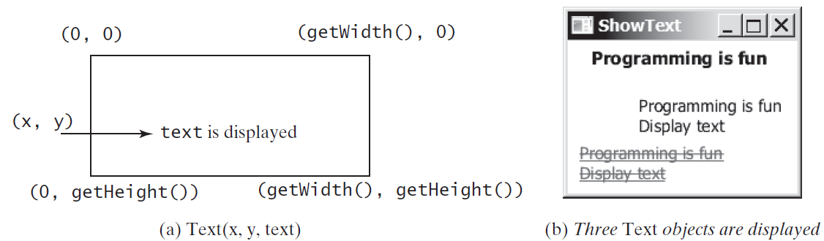
Text Example
ShowText
Run

Slide 13
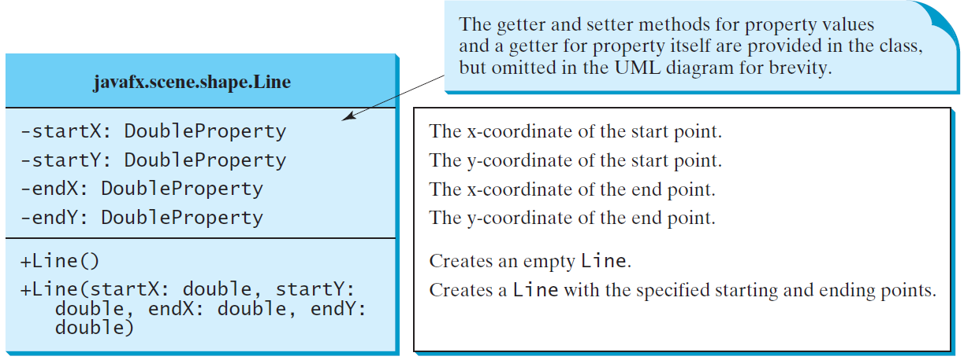
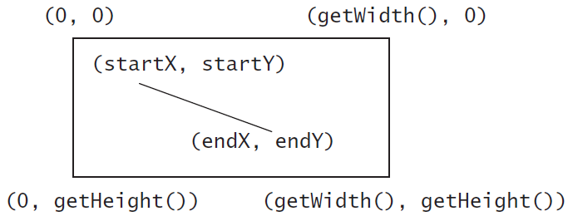
Line
ShowLine
Run

Slide 14
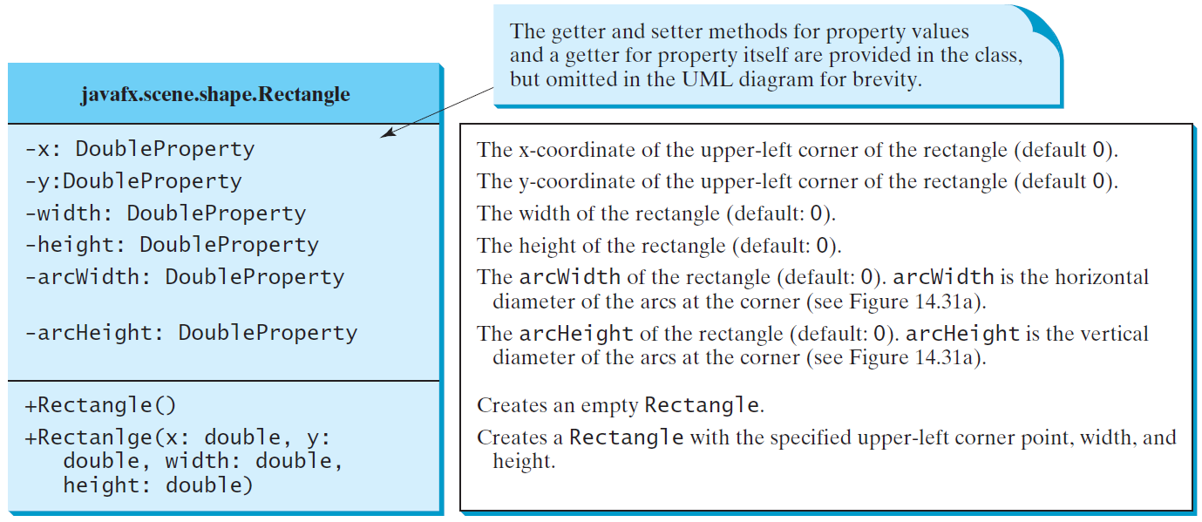
Rectangle

Slide 15
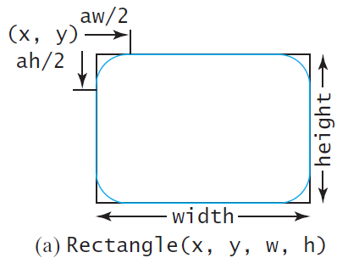
Rectangle Example
ShowRectangle
Run

Slide 16
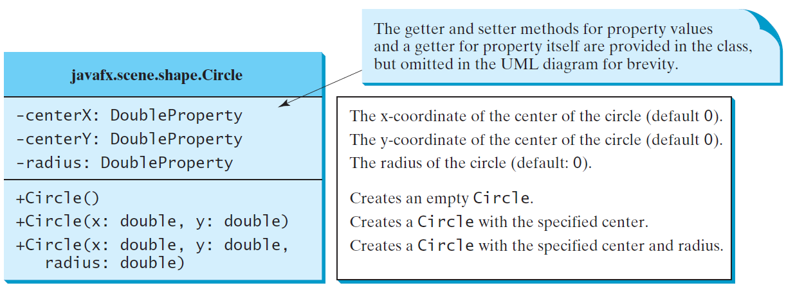
Circle

